Slide 1
Machine Learning Classification
Assigment documendation

Slide 2
Problem Statement or Requirement:
A requirement from the Hospital, Management asked us to create a predictive model which will predict the Chronic Kidney Disease (CKD) based on the several parameters. The Client has provided the dataset of the same.
1.) Identify your problem statement:
Given dataset has Numerical value, So, it comes under the Machine Learning.
Given input and output data is very clear. So, It comes under the Supervised learning.
Given output is like yess or no type . So, It is comes under the Classification.
The client is asking to predict the chronic kidney diease, by given datast.This AI model name is CKD-prediction

Slide 3
2.) Tell basic info about the dataset (Total number of rows, columns)
Rows : 399 & Column : 28
3.) Mention the pre-processing method if you’re doing any (like converting string to number – nominal data)
In the dataset set some Categorical datas there,its like nominal data so we are going to use the one hot encoding to convert that categorical data to numerical data

Slide 4
4.Develop a good model with good evaluation metric. You can use any machine learning algorithm; you can create many models. Finally, you have to come up with final model
I have created the AI models by using the machine learning algorithms like Support Vector classification, Decision Tree classification, Random Forest classification. Logistic regression ,KNN and NAVIE BAYES
I have usd gridsearchCV and standardscaler for the best module creation , I got in best accuracyin randomforest classification.so I took this module as my best brain.i attached everything below

Slide 5
5.) All the research values of each algorithm should be documented. (You can make tabulation or screenshot of the results.)

Slide 6
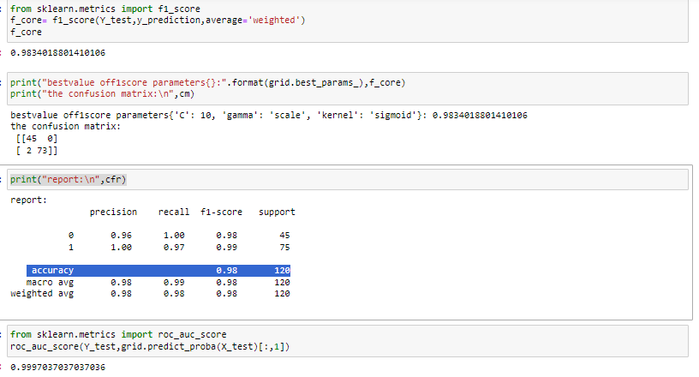
SVC

Slide 7
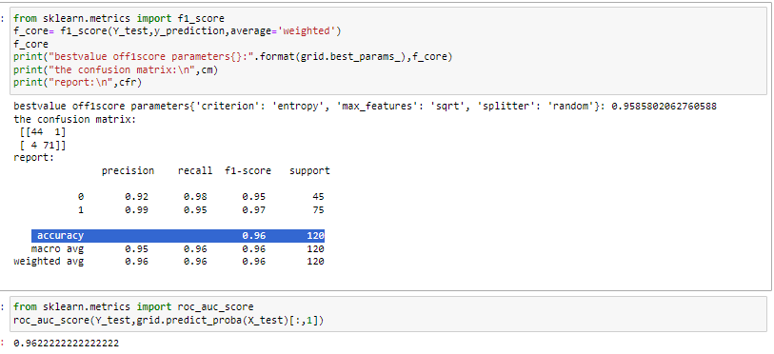
DTC

Slide 8
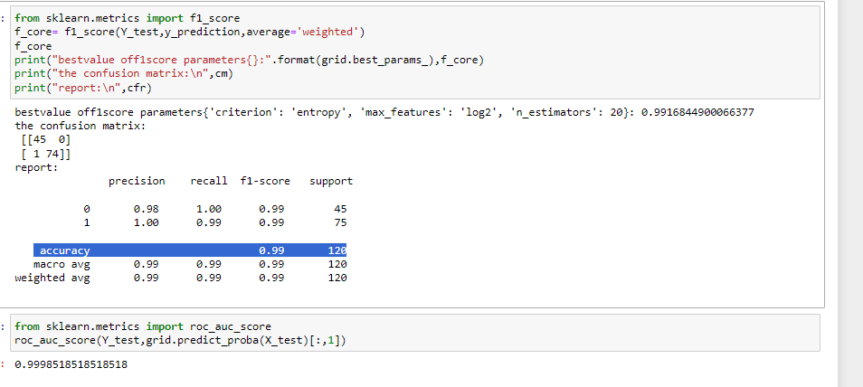
RFC

Slide 9
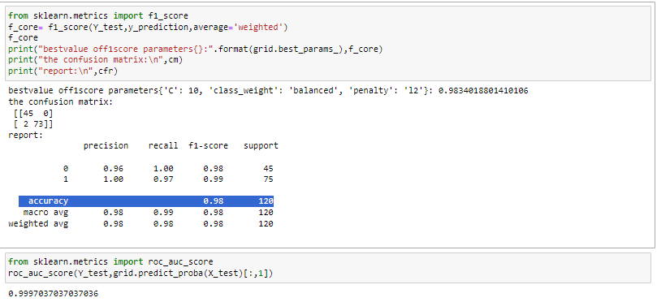
LOGISTIC C

Slide 10
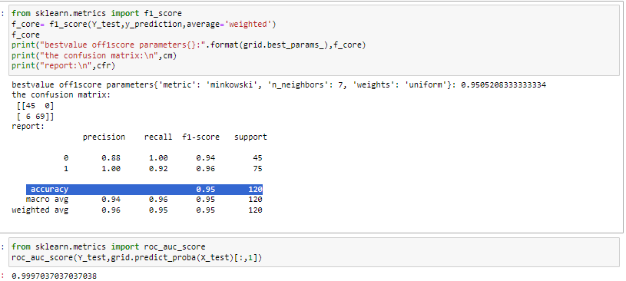
KNN

Slide 11
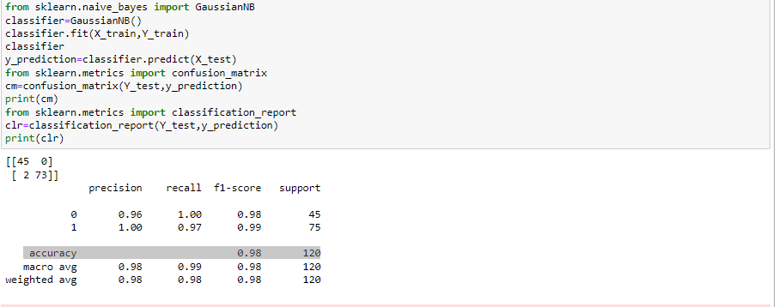
NVBAYES

Slide 12
6.) Mention your final model, justify why u have chosen the same.
Random Forest clssification is giving best accuracy value 0.99 better then others and the r2_score value is 0.9998and the best parameters are criterion:entropy,max_features:log2,n_estimators:20 so I choosed this AI brain for the CKD PREDICTION

